Slide 1


BHAGWAN MAHAVIR COLLEGE OF COMPUTER APPLICATION
HAMMING-CUT MATCHING
ALOGORITHM
____________________________________
Guided By:
Prof. Krupa D Patel
Presented By:
Mr. Singh Amit S.

Slide 2
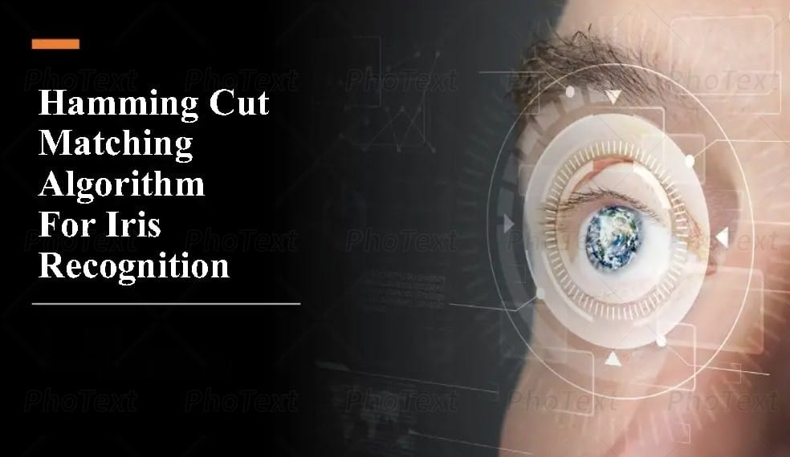

Slide 3
INTRODUCTION
WHY IS IT IMPORTANT?
KEY APPLICATIONS
BASIC CONCEPT
HAMMING DISTANCE CALCULATION
GRAPH MATCHING THEORY
STEP-BY-STEP EXPLANATION
FLOWCHART STRUCTURE
REAL-WORLD USE CASES
ADVANTAGES & DISADVANTAGES
FUTUR SCOPE & IMPROVEMENTS
REFERENCES
CONCLUSION
Contents

Slide 4
INTODUCTION
Human is different each other. Even they are twins, they are still not identical in deep. In general way, we differ our self with a name.
Each time human was born into the world, we give a name to recognize him or her among others.
Therefore, we called "a name" as an human identity. Besides that, we could identify someone from his or her characteristic.
Normally, we identify by looking his or her skin colour, face shape, height, body, etc. Those characteristic are included to be as visible characteristic. More on, visible characteristic means that the identification is simple to do it.

Slide 5
Invisible characteristic is harder to do the identification.
Even hard to do, invisible characteristic is more accurate and unique.
In invisible characteristic, using DNA, finger, face, and any of human part that could be used as an identity.
So, every human has their own information that differs to others.
In study research, this knowledge called by Biometric System.
Biometric system provides automatic identification of an individual based on an unique feature or characteristic

Slide 6
WHY IS IT IMPORTANT?
The Hamming Cut Matching Algorithm is a significant computational tool with diverse applications due to its ability to efficiently compare and match patterns based on Hamming distance—a measure of dissimilarity between two strings of equal length. Here's why it's important and where it's applied:

Slide 7
IMPORTANCE
Efficiency in Pattern Matching: It excels in comparing large datasets by minimizing computational overhead, making it ideal for real-time applications.
Error Detection and Correction: By identifying mismatches, it plays a crucial role in ensuring data integrity in communication systems.
Scalability: Its adaptability to handle massive datasets makes it a preferred choice in fields requiring high-speed processing.

Slide 8
KEY APPLICATIONS
Network Optimization:
Used in routing algorithms to optimize data flow and reduce latency.
Enhances network reliability by identifying and mitigating errors in data transmission.
Artificial Intelligence (AI):
Facilitates image and speech recognition by comparing feature vectors.
Plays a role in natural language processing for tasks like text similarity and clustering.
Bioinformatics:
Crucial in DNA and protein sequence analysis, helping identify genetic similarities and mutations.
Assists in phylogenetic studies to trace evolutionary relationships.

Slide 9
BASIC CONCEPT
1. Hamming Distance
The Hamming Distance measures the number of positions at which two strings of equal length differ. For instance:
Consider two binary strings: 10101 and 11100
The Hamming Distance is 3, as they differ in the first, fourth, and fifth positions.
This concept is used in error detection and correction, like ensuring data integrity in digital communication.

Slide 10
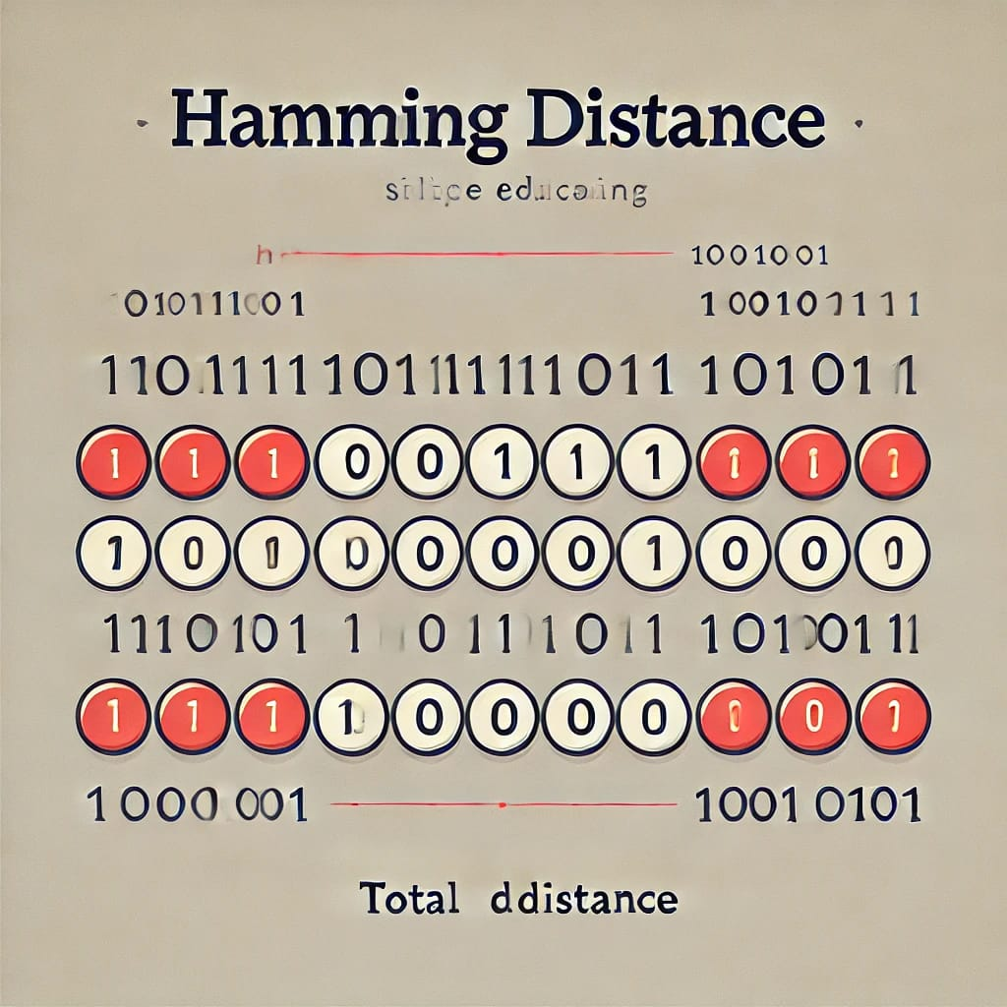

Slide 11
2. Graph Matching
Maximum Matching:
Find the largest possible matching.
Perfect Matching:
Find a matching that includes every vertex (if possible).
3. Cut (in Graph Theory)
Cut Size:
The number of edges in the cut-set.
Minimum Cut:
A cut that minimizes the number of edges crossing between the two subsets.

Slide 12

HAMMING DISTANCE CALCULATION
Problem:
Calculate the Hamming Distance between these two binary strings:
String 1. 110101
String 2. 101001
Step-by-Step Process
Write both strings side by side:

Slide 13
2. Compare each Position:
Position 1: Both are 1 → Same (no difference).
Position 2: 1 vs 0 → Different.
Position 3: 0 vs 1 → Different.
Position 4: 1 vs 0 → Different.
Position 5: Both are 0 → Same (no difference).
Position 6: Both are 1 → Same (no difference).
3. Count the differing positions:
Differences occur at positions 2, 3, and 4, which totals 3 differences.
4. Conclusion:
The Hamming Distance between 110101 and 101001 is 3.

Slide 14
Graph Matching Theory
Graph matching refers to finding correspondences between vertices or edges of two graphs, or identifying subsets within a single graph that meet specific criteria. It’s often used in scenarios like resource allocation, pattern recognition, and network analysis.
How Graphs are used for matching and optimization?
Key Concepts:
Matching in Graphs
Maximum Matching
Weighted Graphs

Slide 15
Graph Optimization:
Graphs are also widely used for optimization problems:
Shortest Path Problems
Maximum Flow Problem
Assignment Problem

Slide 16
Step-by-Step Explanation
1. Input and Initialization:
Input the graph, where nodes represent binary strings and edges are weighted by their Hamming distances.
Define parameters for the desired number of partitions or cluster properties.
2. Graph Representation:
Construct a graph with nodes as binary strings.
Assign edge weights based on Hamming distance between connected nodes.
3. Cut Initialization:
Form an initial random "cut" to split the graph into two subsets.
This acts as the starting point for segmentation.

Slide 17
4. Matching Phase:
Identify pairs of nodes with minimal Hamming distances.
Create "matchings" of similar nodes, grouping these into the same cluster.
5. Graph Contraction:
Contract the graph by merging matched nodes into super-nodes.
This simplifies the structure for further segmentation.
6. Graph Contraction:
Contract the graph by merging matched nodes into super-nodes.
This simplifies the structure for further segmentation.
7. Iterative Segmentation:
Repeat the process of matching, contracting, and optimizing until the graph is sufficiently segmented.
8. Output:
Output the final segmented graph, where subsets of nodes represent clusters with minimized internal Hamming distances.

Slide 18
FLOWCHART STRUCTURE:
Start → Receive the input graph.
Construct Graph → Represent nodes and assign edge weights based on Hamming distance.
Initialize Cut → Create the initial cut.
Matching → Pair nodes with minimal Hamming distances.
Contract Graph → Merge matched nodes into super-nodes.
Optimize Cut → Adjust the cut for balance and minimized edge weights.
Check for Convergence → If segmentation is not optimized, repeat the steps.
End → Output the segmented graph.

Slide 19
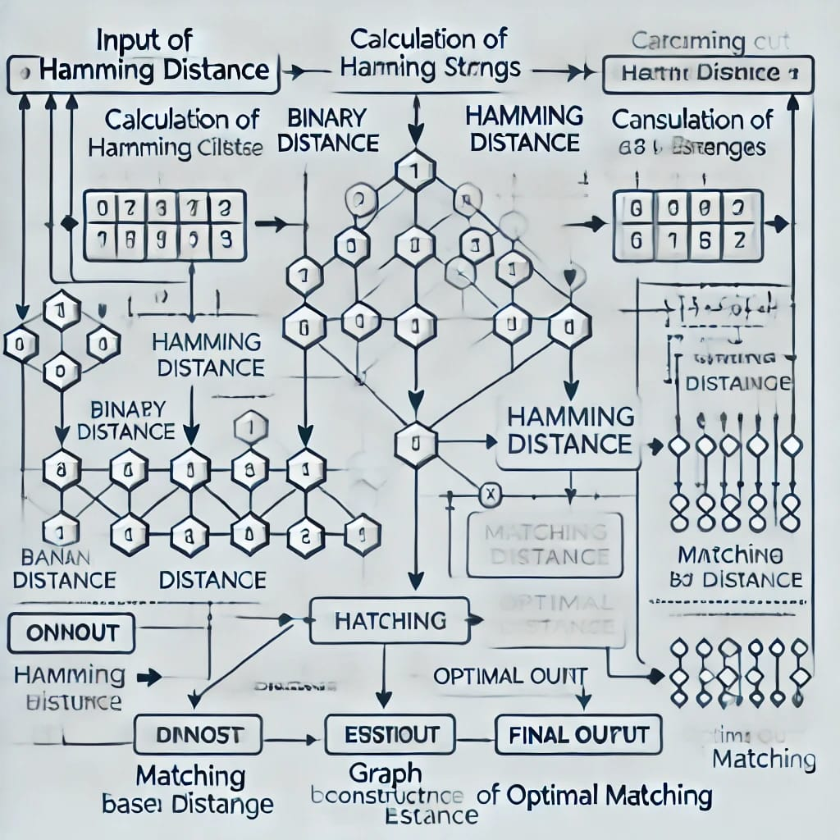

Slide 20
REAL-WORLD USE CASES
Biometric Systems:
Iris Recognition: Commonly used for comparing iris codes in biometric systems, ensuring high precision and reliability in identity verification. For instance, it plays a role in airport security to authenticate travelers' identities
Fingerprint Matching: Variations of the algorithm are implemented in matching fingerprint patterns in access control systems.

Slide 21


Slide 22
2. Access and Security:
Identity Verification: Utilized in systems like e-passports and national ID programs to compare stored and live biometric samples for authentication.
Banking Security: Applied in banking for secure customer identification, protecting sensitive financial information.
3. Healthcare:
Medical Imaging: Used in analyzing binary data from scans like retina images, assisting in detecting unique patterns for medical diagnoses.
4. Research and Data Analysis:
Pattern Recognition: Helps researchers analyze binary datasets, such as gene sequences, where recognizing subtle differences is critical.

Slide 23
Advantages & disadvantages
High accuracy in pattern matching.
Low false acceptance and rejection rate.
Supports contactless hygienic authentication.
Effective for unique and fine - grained identification.
Relieble in secure environmnts.
Sensitive to noise in the input data.
Require data of equal length for comparison.
Struggles with scalability in large dataset.
Dependent on high quality inout data.
Limited ability to handle multiple simultaneous error.

Slide 24
FUTURE SCOPE & IMPROVEMENTS
The future scope of the Hamming Cut Matching Algorithm is promising, especially in fields requiring precise pattern recognition and matching.
Enhanced Biometric Systems: As biometric technologies evolve, the algorithm could be further optimized for applications like iris, fingerprint, and facial recognition, ensuring higher accuracy and faster processing
AI and Machine Learning Integration: By integrating with AI and machine learning models, the algorithm could adapt to handle larger datasets and improve its error-handling capabilities.
Cybersecurity: It could play a role in secure authentication systems, such as multi-factor authentication, to enhance data protection.

Slide 25
4. Healthcare Applications: The algorithm might be used in medical imaging to compare patterns in diagnostic scans, aiding in early disease detection.
5. Big Data Analytics: With advancements, it could be adapted for large-scale data comparison tasks, such as genome sequencing or analyzing massive datasets.

Slide 26
REFERENCES
Books:
"Biometric Systems: Technology, Design, and Performance Evaluation" by James Wayman , Anil K. Jain , and others, for a comprehensive guide on biometric matching algorithms.
Pattern Recognition Machine Learning" by Christopher M. Bishop, which covers techniques relevant to this algorithm.
Research Papers:
Articles from journals like IEEE Transactions on Pattern Analysis and Machine Intelligence, or Springer’s Pattern Recognition journal, often feature work on algorithms like this one.
Online Resources:
Look for academic articles on platforms like Google Scholar or PubMed.

Slide 27
CONCLUSION
The Hamming Cut Matching Algorithm is a reliable tool for matching patterns, especially in biometrics like iris recognition, due to its accuracy and efficiency. However, it faces challenges with noise, large datasets, and the quality of input data. By integrating advancements like AI, it holds great potential for growth in fields like security, healthcare, and data analysis.

Slide 28
THANK YOU
FOR YOUR ATTENTION !

